Slide 1
The "Always Win the Listing" Marketing Suite

Slide 2
The "Always Win the Listing” Marketing Suite

Slide 3
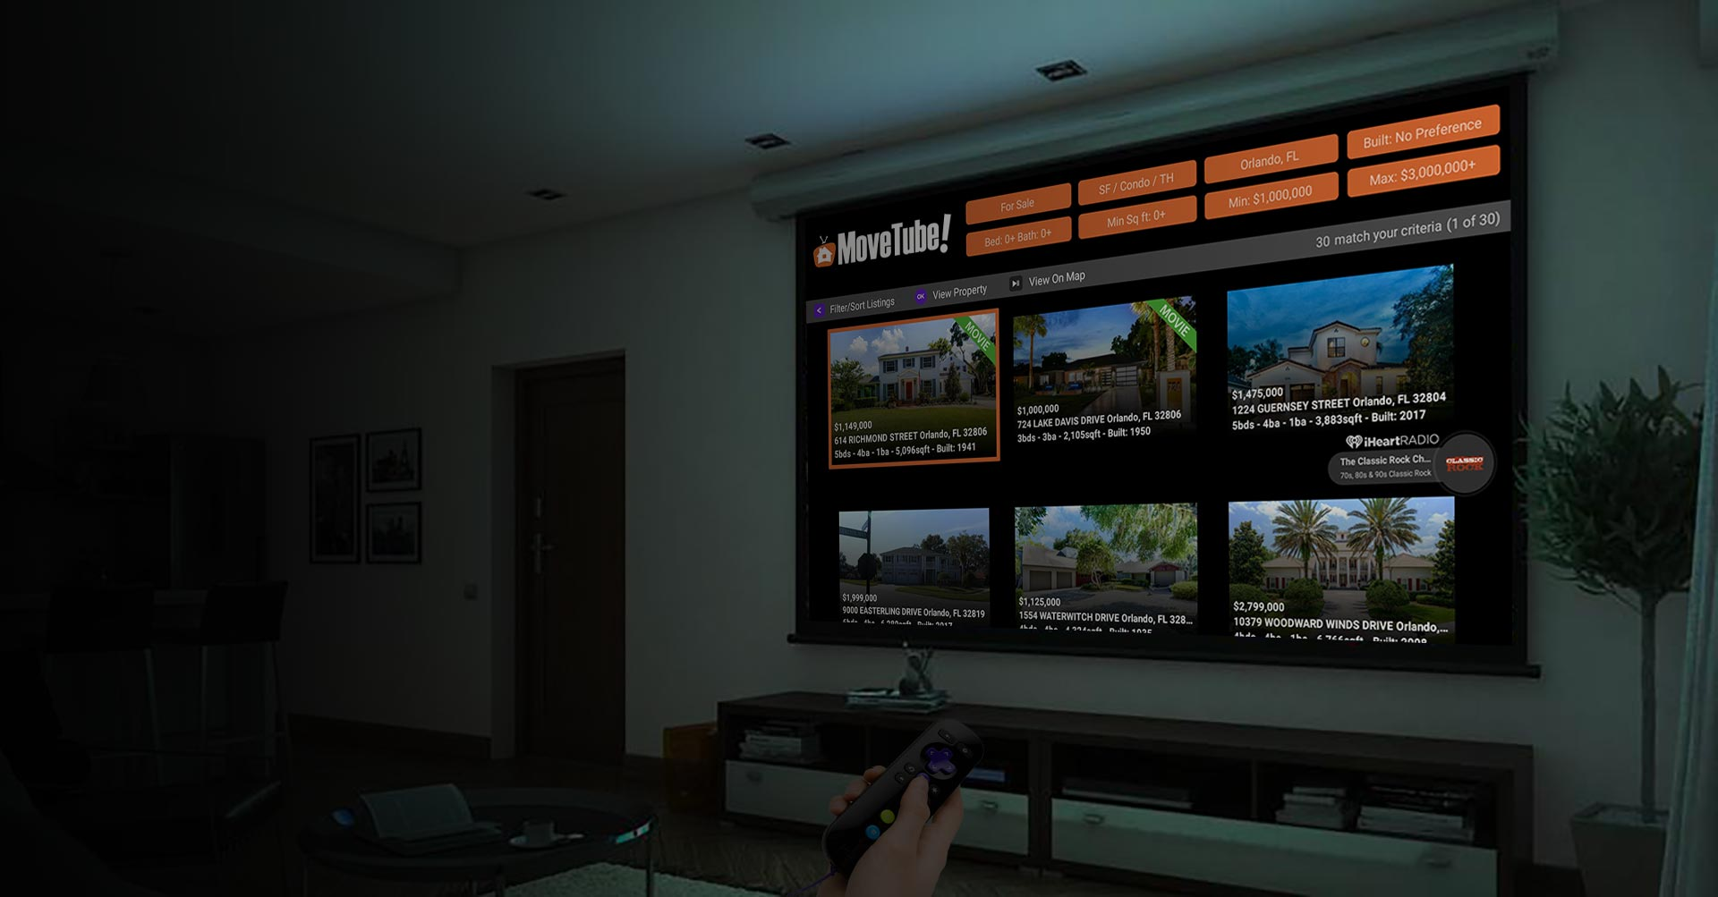
MoveTube® is the only interactive national real estate search portal available on all the popular streaming television devices.
“Once we found MoveTube on Roku we stopped using Z****w. When we got used to the large photos on our 70 inch 4K TV screen we didn’t want to go back to using the phone or PC. Our home search is now a family entertainment event.” Tim Jenson
“What? You can place my listing on Roku???
I didn’t even know that was possible. Okay, where do I sign?” As told to us by Q. McGlory, Realtor in California from one of his listing prospects.
Music feature powered by
© 2021 iHeartMedia, Inc.

Slide 4
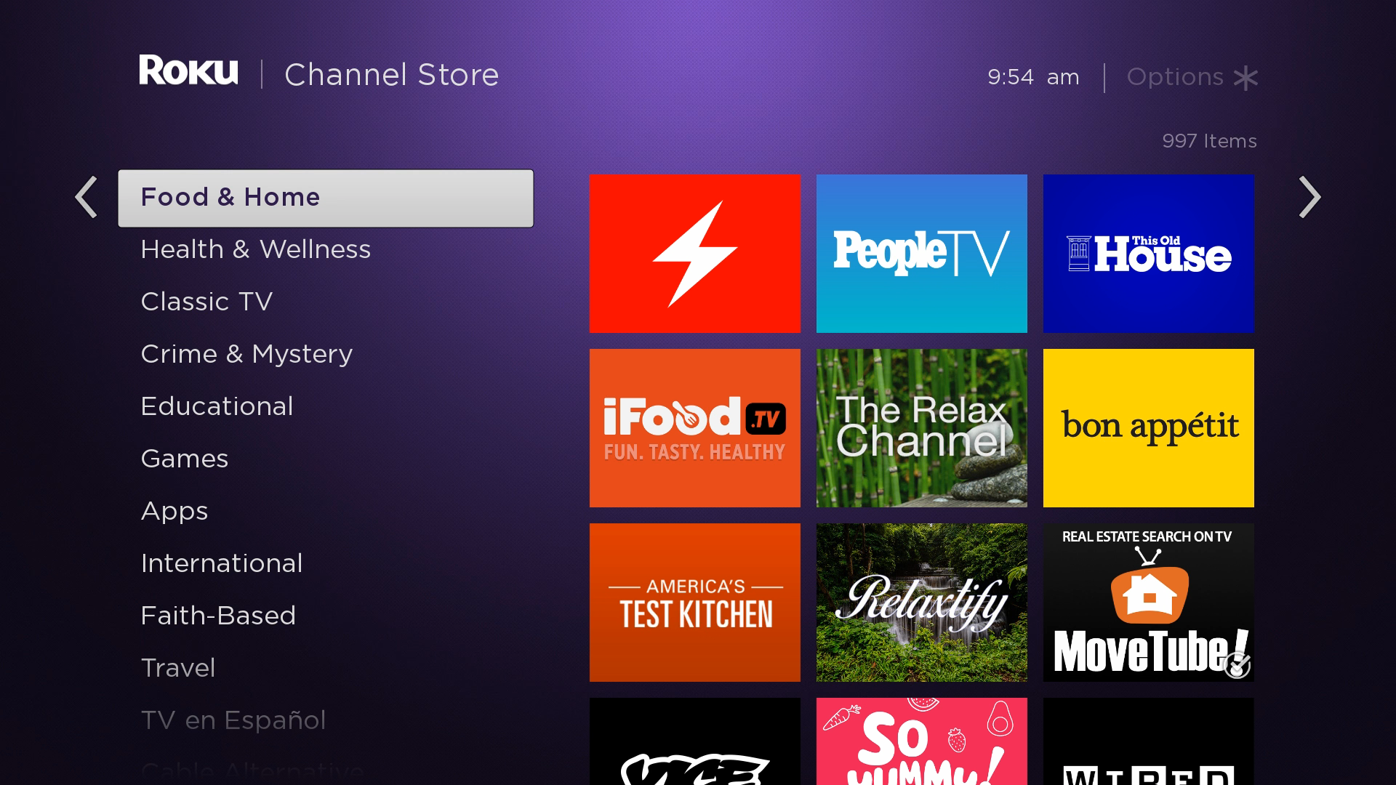
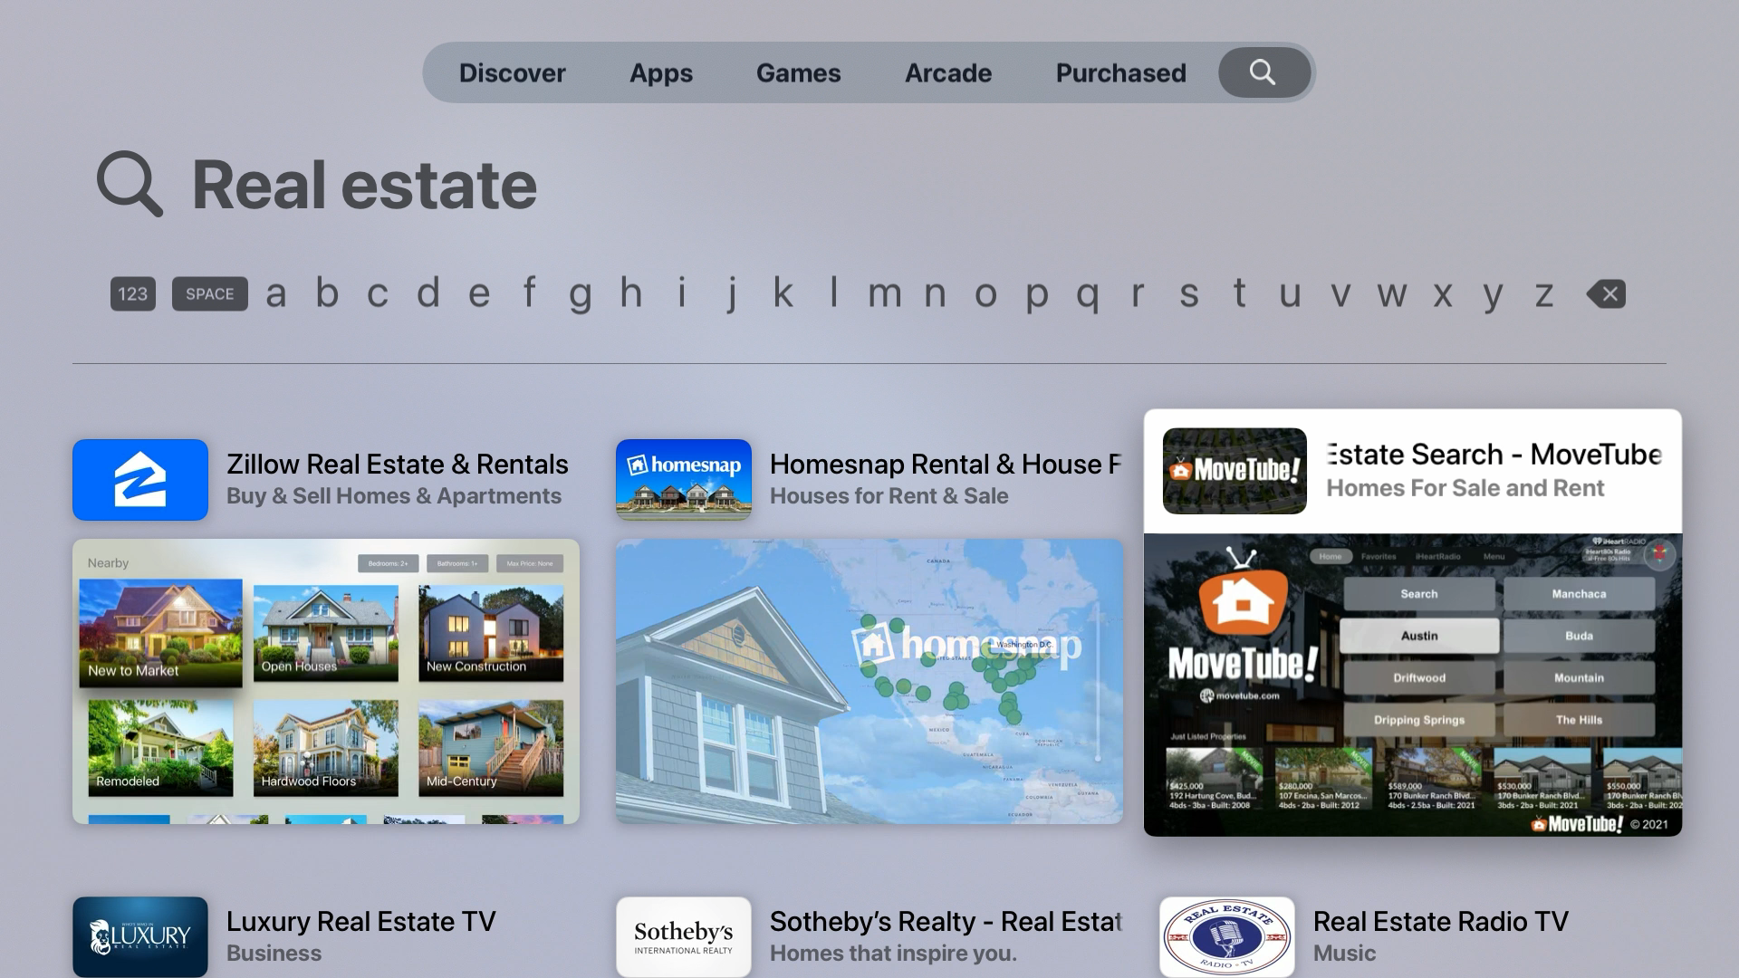
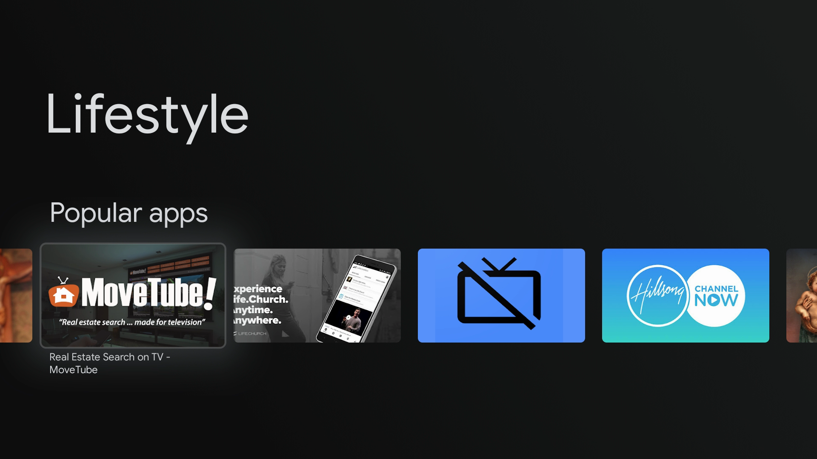
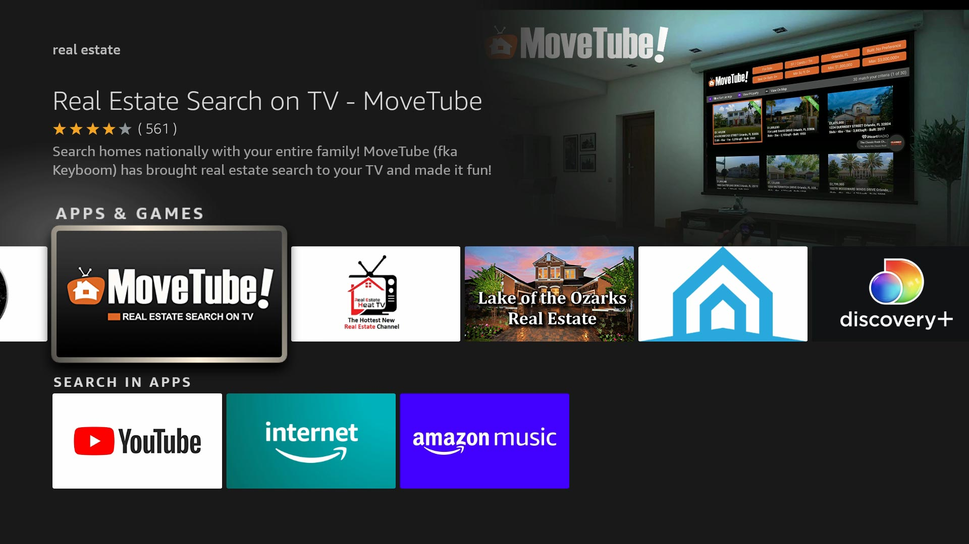
Where to find MoveTube on streaming television?
Roku: Always in the top 10 of its channel category and the only national real estate search app on Roku. Roku is the most popular TV device.
Apple TV: The highest rated real estate search app on Apple TV. Apple TV is very popular with iPhone and Mac users.
Google/Android TV: The only interactive national real estate search app
on this platform. Android TV is being built into many televisions today.
Amazon Fire: The only interactive national real estate search app on this platform. Amazon Fire TV is the second most popular device behind Roku.

Slide 5
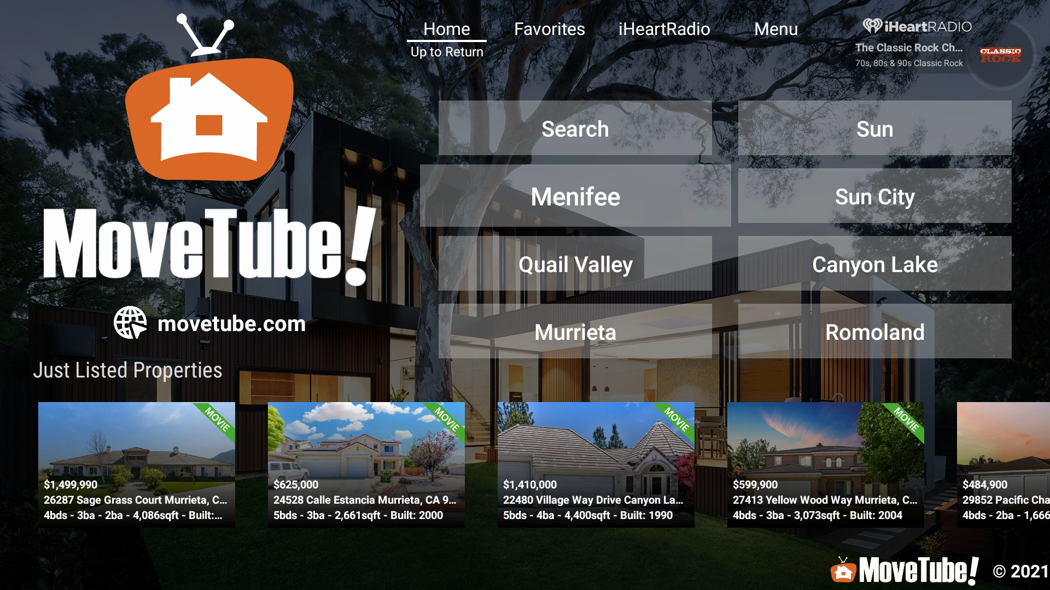
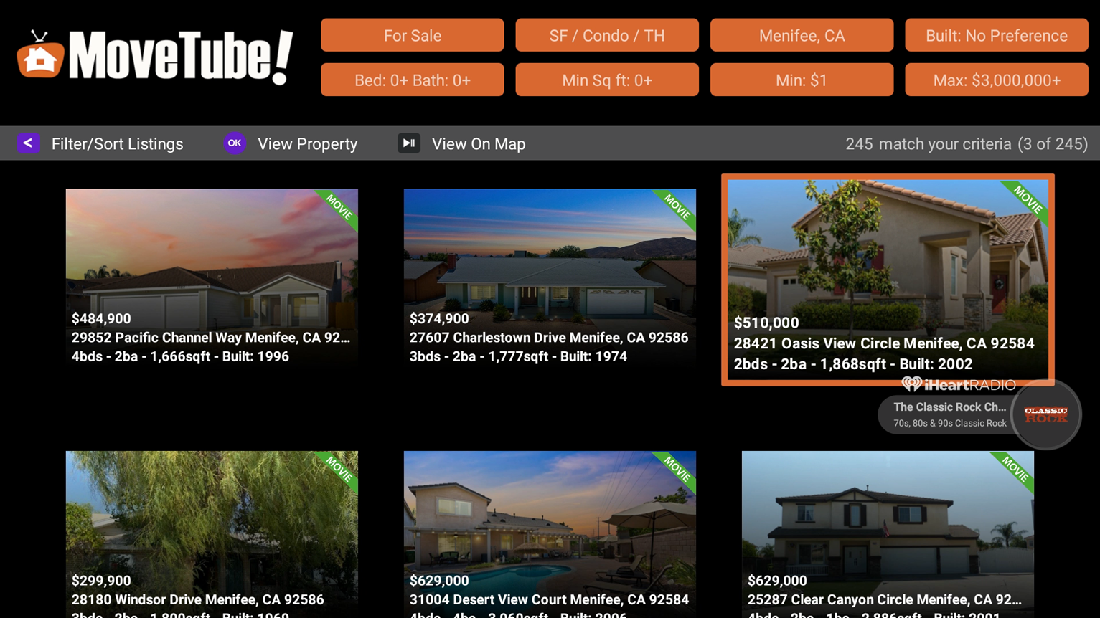
Listings imported into Listing Booster get premier placement and are enhanced with “movies” on MoveTube. They also appear on the home screen when “Just Listed” in their area.

Slide 6
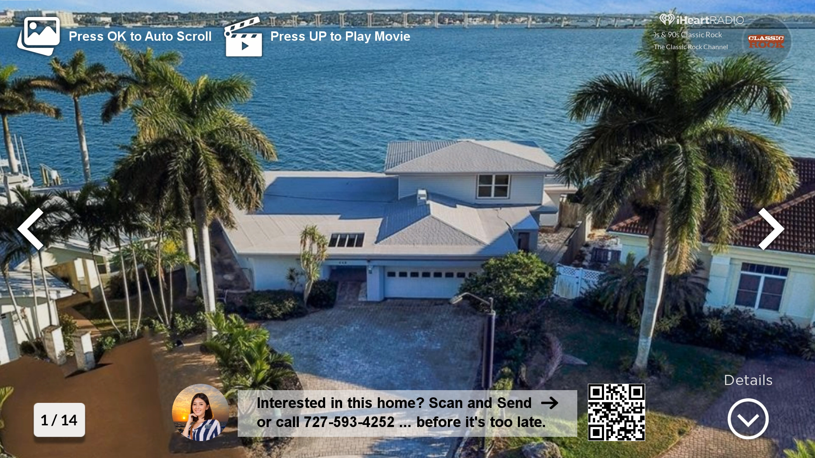
Listing Booster agents are featured on their listing screens and movies.

Slide 7
Each Listing Booster agent listing is enhanced with an animated
slide show movie and featured in the screensaver.

Slide 8
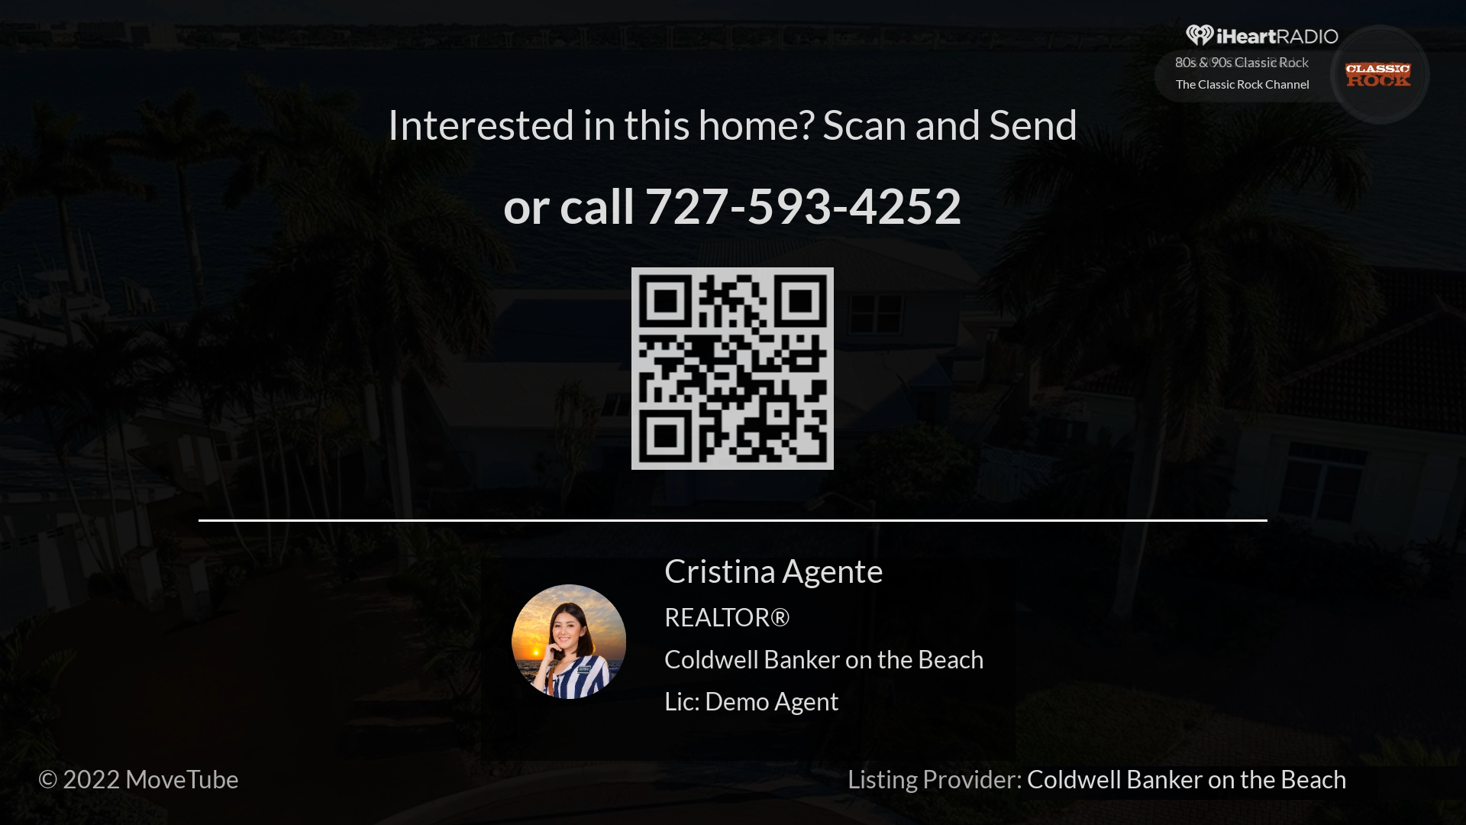
Each listing movie and listing screensaver segment concludes with the contact agent screen.

Slide 9
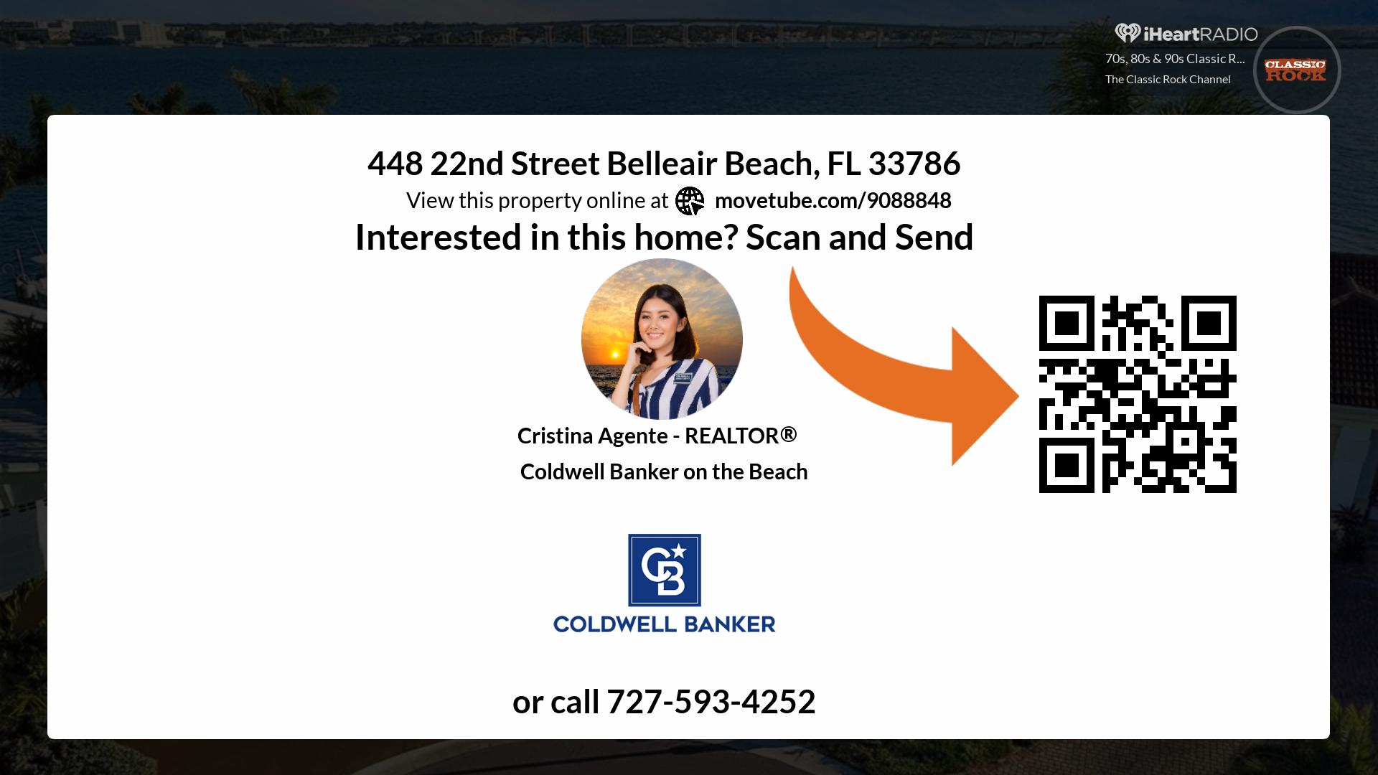
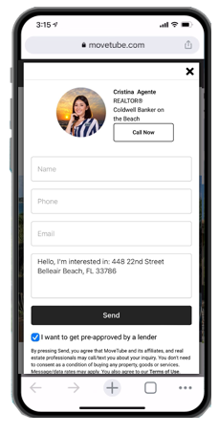
Listing Booster agents get their own agent panel screen on their listing and can be contacted by scanning the QR code.

Slide 10
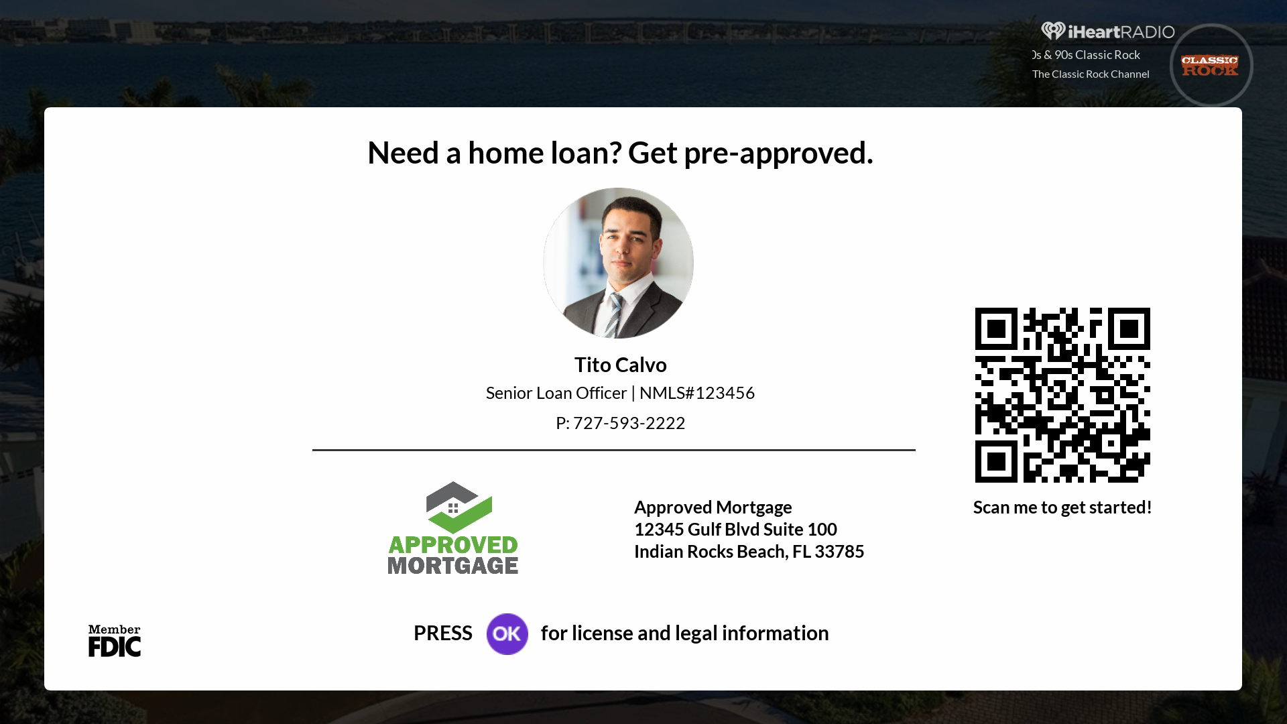
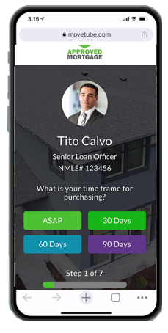
Listing Booster loan officers get their own lender panel screen on their agent’s listings. The QR codes open up their branded mobile pre-approval form.

Slide 11
Agents, leverage MoveTube® to win your listings! Tell your seller prospects that you will be featuring their listing on all the popular streaming TV devices, Roku, Apple TV, Amazon Fire TV, Android and Google TV.
You will then announce their listing on social media with a short “movie” trailer video called a “Listing Trailer”. Don’t leave this out because agents are telling us that it is a big difference maker when prospects are deciding on which agent to choose.
Music feature powered by
© 2021 iHeartMedia, Inc.

Slide 12
Announce new listings with Hollywood style 30 second “Listing Trailers” with “movie trailer guy” narration and cinematic music. Designed for social media platforms like TikTok, Facebook, and Instagram.

Slide 13
The Rest of the
Marketing Suite

Slide 14
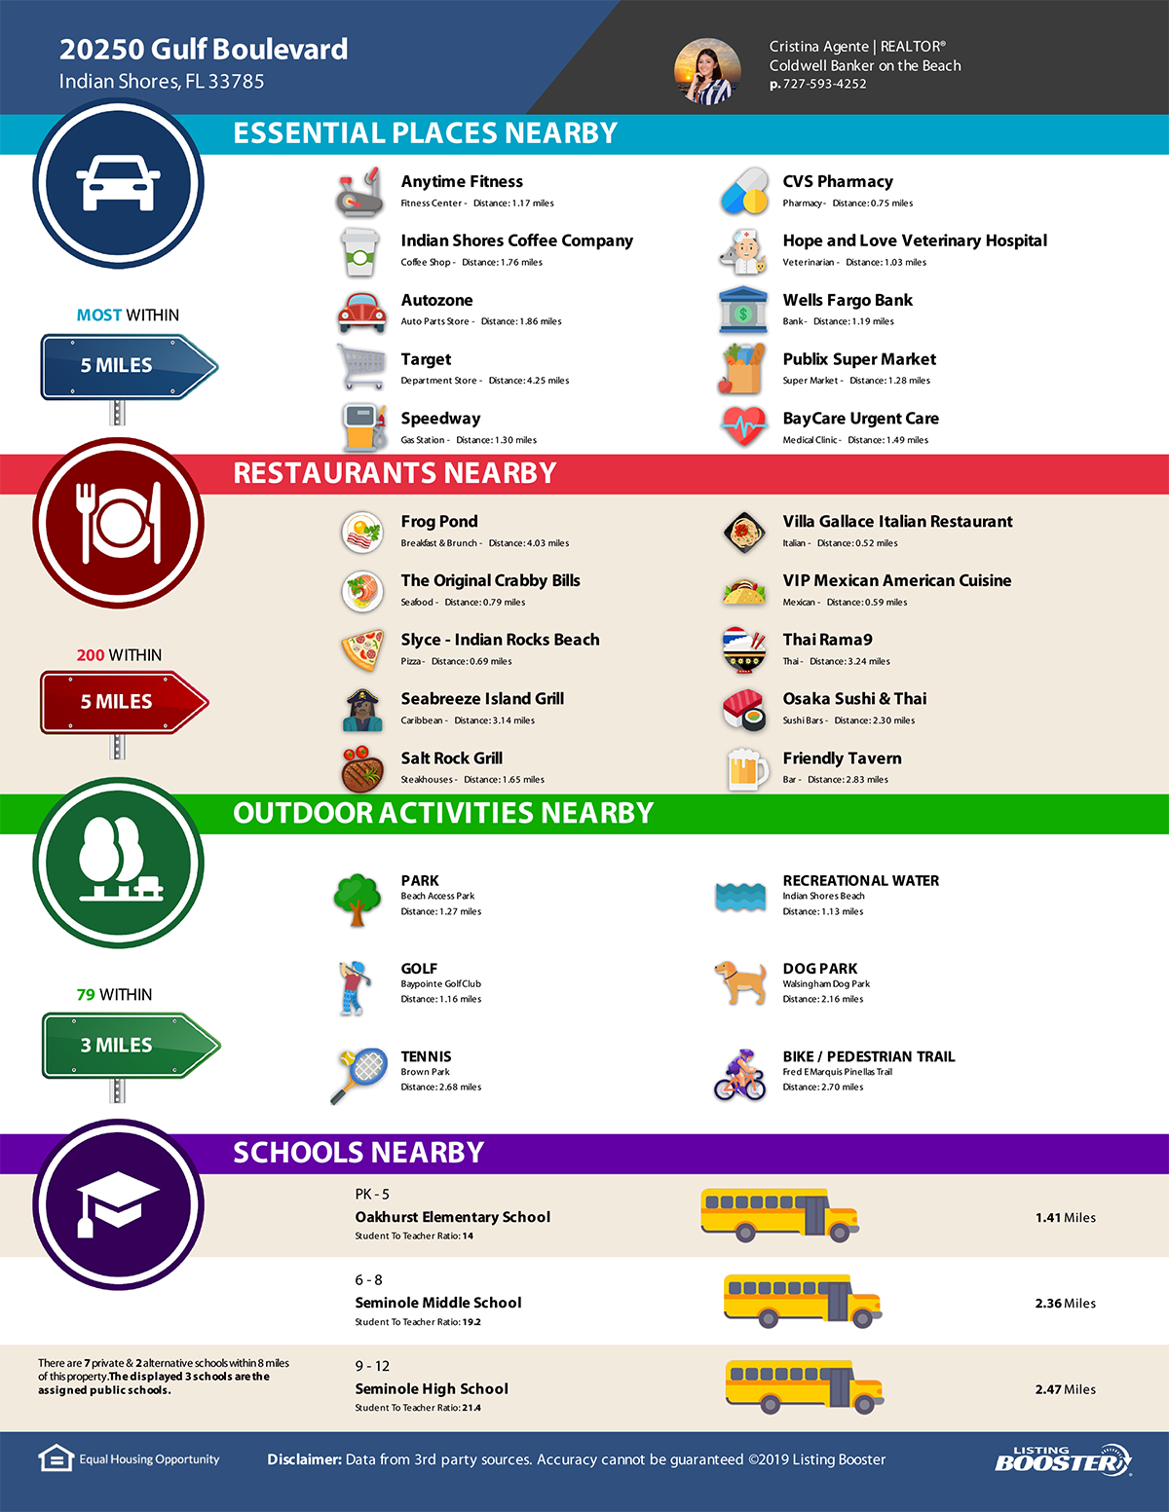
Just Listed, Open House, Sold, etc digital and print flyers with local data that makes you the local expert.

Slide 15
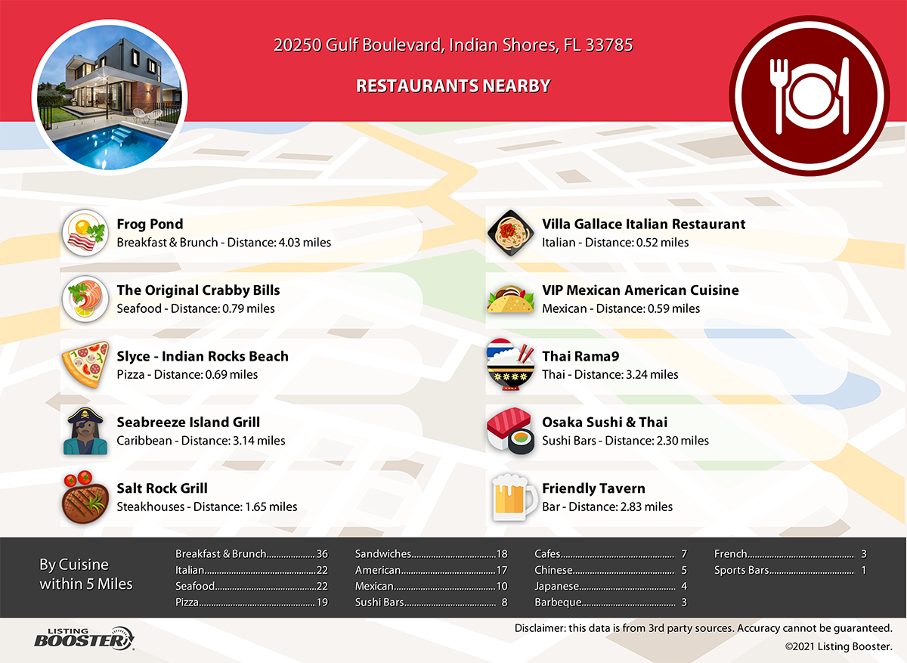
Social media shareable digital property reports designed to not only sell the property but also the area.

Slide 16
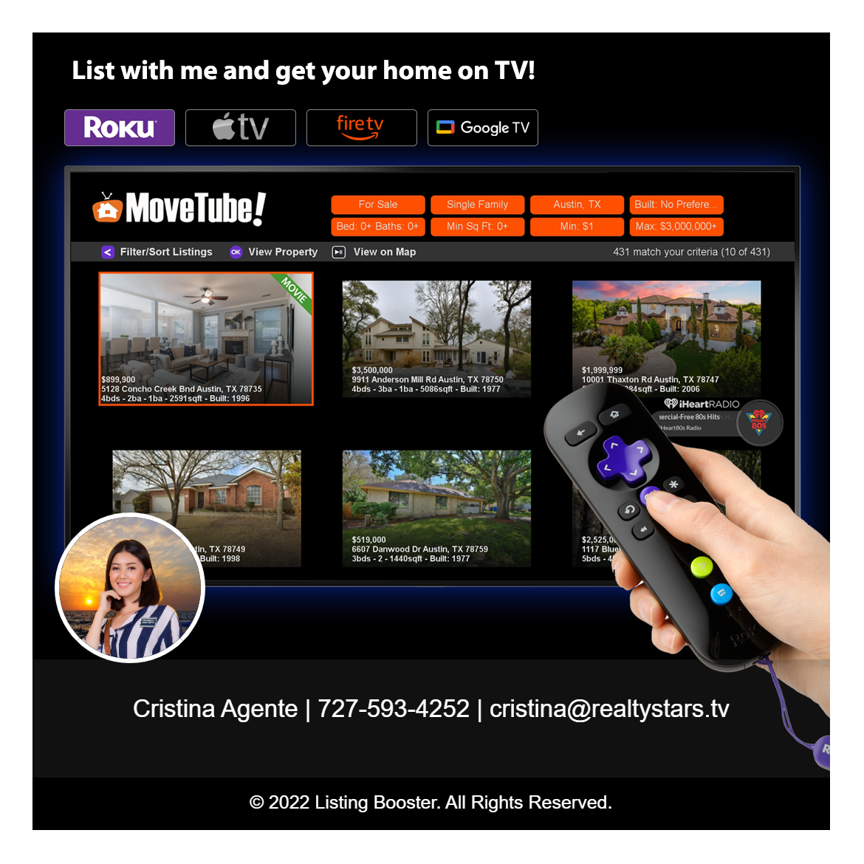
“Social Media Images” ideal for sharing on most social media platforms. Many versions available and colors can be changed to match you company theme.

Slide 17
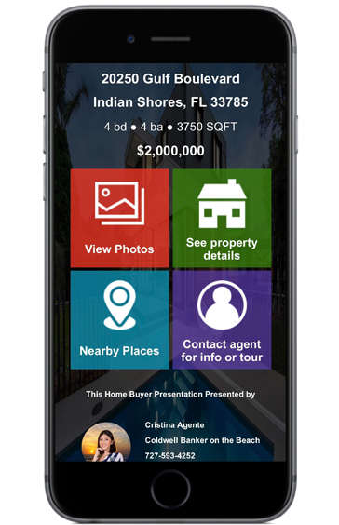
Each listing receives a dedicated SMS code that can be added to digital ads and sign riders. Perfect for instantly delivering listing
data to prospects and lead capture!

Slide 18
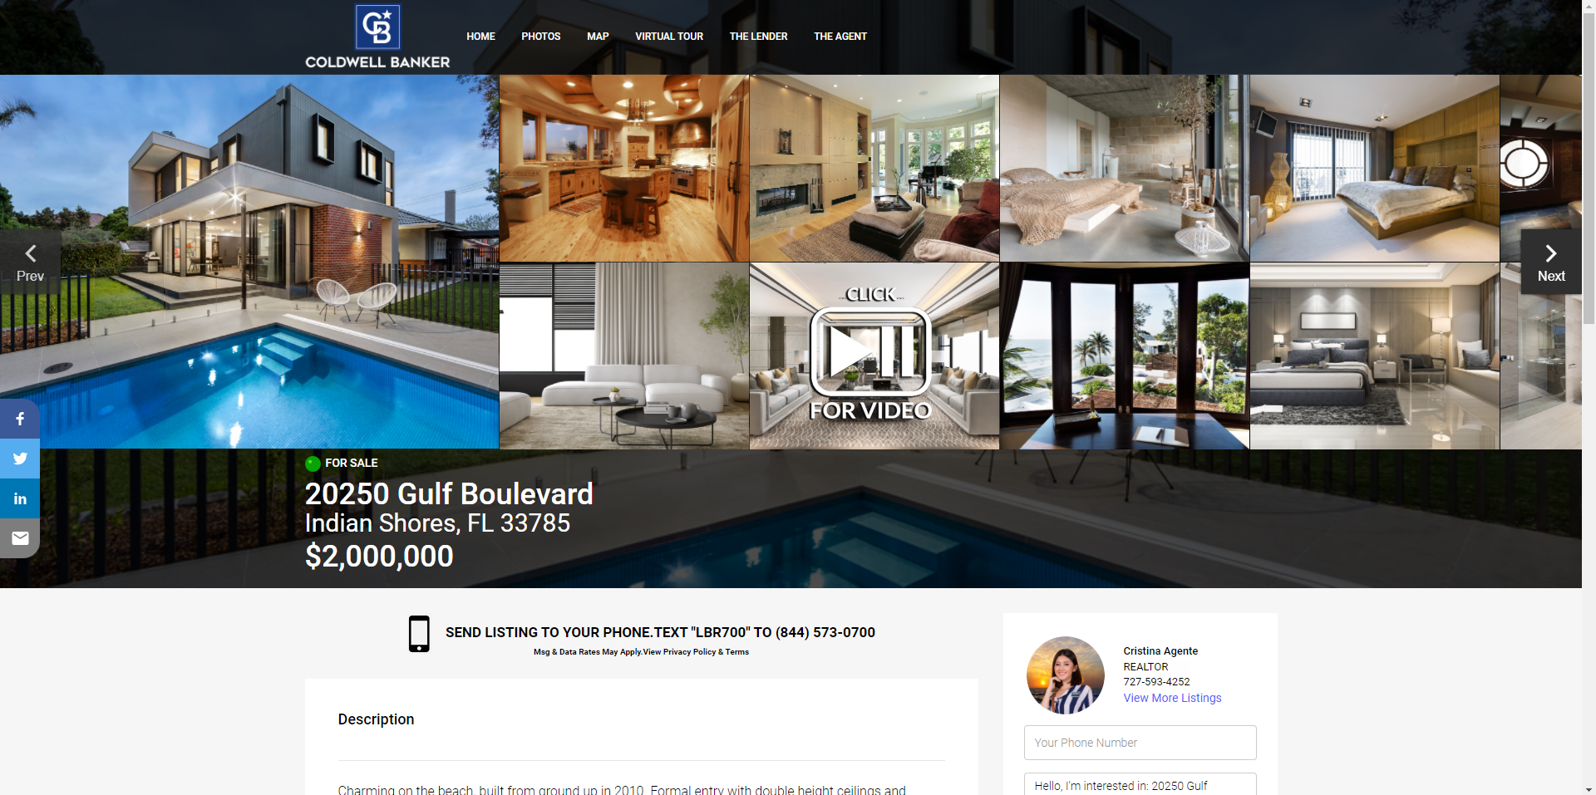
Property websites might be old news to us. However, sellers are still always impressed with having a website dedicated to their property. Each comes with an optional lead capture “opt-in” pop up. Never leave this feature out of your listing presentation.

Slide 19
Show off your listings with a full screen animated / virtual tour. Available in both branded and MLS compliant non-branded.

Slide 20
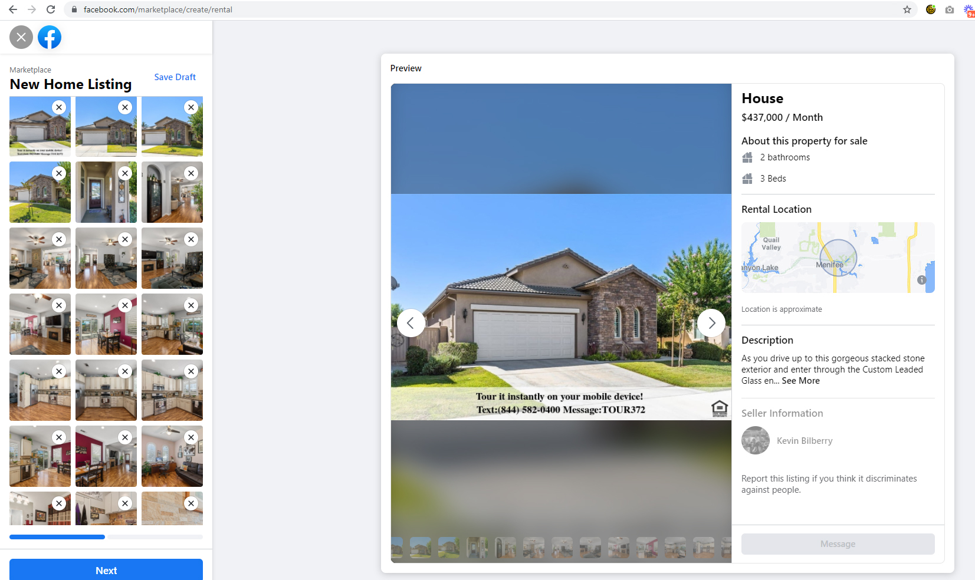
Manage your listings on Facebook Marketplace with your Facebook Marketplace Posting Tool.

Slide 21
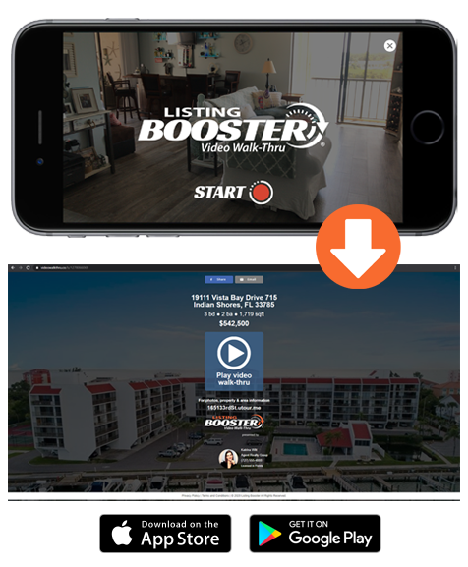
Video Walk-Thru mobile app designed to easily record video on your listings. The feature is now available however is still being enhanced.

Slide 22
Now it’s time to let the seller know EVERYTHING that you will be offering with our modifiable PowerPoint Listing Presentation. This presentation highlights all the features of Listing Booster to help you win the listing. Easily add your branding and additional slides if needed. This presentation is downloadable right inside the dashboard.

Slide 23
listingbooster.com

